Slide 1
Firmware Over the Air
Project Proposal

Slide 2
Team members
Ahmed Adel Qandeel.
Amr Ibrahim Nobe.
Marcelle Samir Isaac.
Marina Medhat Zekry.
Mohanad Fawzy Sallam.
Mostafa Nader Eltourky.

Slide 3
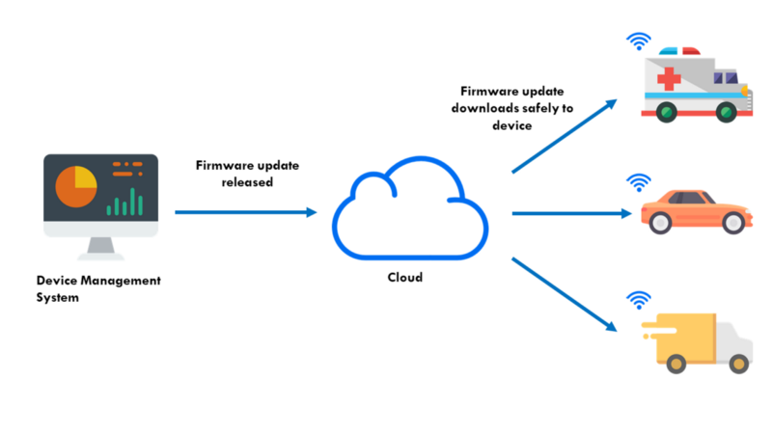
Project Overview
Raspberry Pi
+
Micro-controller
Server
PC Application
1
2
3

Slide 4
Project sub-systems
PC Application system.
RaspberryPi system.
µC system.

Slide 5
Project Block Diagram
PC Application
µC
Rπ
3
1
2
Server
4
5

Slide 6
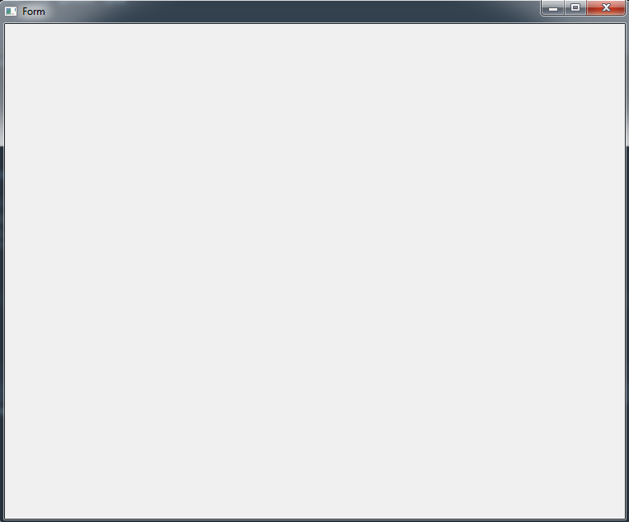
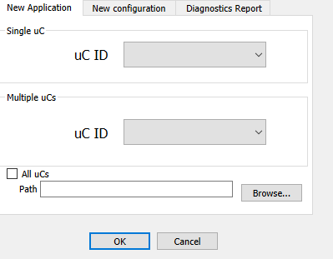
First Sub-System: PC Application
Select µC (s).
Select New Application .elf file
Click Ok to start flashing
Pc Application

Slide 7
First Sub-System: PC Application
After The Application is written to the uC, the Pc will receive a confirmation message (Confirmation Report).
Pc Application

Slide 8
First Sub-System: PC Application
New Configuration and Diagnostics Report are considered as an extra Features.
New configurations will flash the new configurations at specified location in µC Rom (post-build configurations).
Diagnostics Report will return a small report that contains:
Flashing Req’s #. ( TODO )
Marker (status) value
( TODO )
Booting times #. ( TODO )
Pc Application

Slide 9
Second sub-system: Raspberry Pi
Considered as the interface between FOTA server and the vehicle.
It gets the .elf file from the server, parse it and send it to µC.
After the .elf is flashed successfully to the µC it sends a confirmation (status) message to the PC Application.

Slide 10
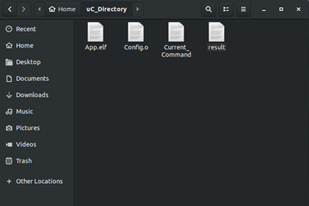
Second sub-system: Raspberry Pi server
Current_command: The PC application will write command code in this file.
The Rπ checks the file and based on the command code it will take suitable action.
PC App -> Rπ.
After executing, the Rπ clears the file.

Slide 11
Second sub-system: Raspberry Pi server
result: The Rπ writes the current process status on this file to generate the status report to the PC App.
The PC will generate the Status report based on the code written in this file .
PC APP <- Rπ.

Slide 12
PC App – Rπ communication
The App sends start signal ( after pressing ok button) by sending the .elf /.o file via internet to the Rπ .
The Application writes command code in the Command_file.
The Rπ (background process) checks the command file and if its not IDLE (new command appears) it will start communication with the µC and send status to the App via result file.
Periodically, The App checks the result file to generate the status message (Report) for the App User.
After finishing with the µC, The Rπ writes finish code to the App.

Slide 13
Rπ - µC communication
After receiving command from the App (via current_command file), the Rπ fetchs the .elf / .o file from the server and start parsing it .
The Rπ will send asignal to the µC to indicate a request for action.
The Bootloader will checks the signal and based on it, the Bootloader will take the suitable procedure.
After finishing with the µC, The Rπ writes finish code to the App.

Slide 14
Rπ - µC communication
After receiving command from the App (via current_command file), the Rπ send command code to the µC by (TODO).
The µC will have trigger (the Rπ signal) that activates certain task and after receiving the trigger signal, the task will change the status flag (marker) and reboots the µC (TODO).
The Bootloader will checks the marker flag and based on the value, it will take the suitable procedure.
After finishing with the µC, The Rπ writes finish code to the App.
There are three types of commands to be given to the µC:
Flash New Sw (Application/ Configuration). (TODO)
Get diagnostic status from the µC. (TODO)

Slide 15
Rπ - µC communication: Frames Types
We have six types of frame.
These frames will be represented (written) in the Data File.
The General structure of the frame consists of Header & body.
The Header starts with start of frame.
The header contains Req number.
The header contains command number.
The body differs from frame type to another.
 | Type
0 | Flash new App Command frame
1 | Flash write sector Frame
2 | Respond Frame
3 | End Flashing Frame
4 | Diagnostic Request Frame
5 | Diagnostic Report Frame

Slide 16
Rπ - µC communication: Frames body
Flash new App Command : Contains FLASH_NEW_APP_KEY, first Address of the app inside the flash, total size of the app and entry point.
Flash write sector Frame: Contains first address of the data sector, sector-size and Data Bytes (up to DATA_MAX Byte per frame).
Respond frame: contains ACK_KEY (OK / NOK).
End Flashing Frame: contains END_FLASHING_KEY.
Diagnostic Request Frame: Contains DIAGNOSTIC_REQUEST_KEY.
Diagnostic Report Frame: (Diagnostic data) (TODO).

Slide 17
Rπ - µC comm: Frames Types
Flash new App Command
Start of frame
Request number
Command number
Flash new App key
App First Address at ROM
App size
App entry point
Flash write sector
Start of frame
Request number
Command number
Sec. first address at ROM
Sector data size
Sector data.
Respond
Start of frame
Request number
Command number
Ack key
Diagnostic Request Frame
Start of frame
Request number
Command number
Diagnostic request key
Diagnostic Report Frame
Start of frame
Request number
Command number
Diagnostic report
End Flashing
Start of frame
Request number
Command number
End Flashing key

Slide 18
Rπ - µC comm: Flash new SW protocol
Raspberry Pi
Flash new App cmd
Micro-Controller
Respond Frame
Flash write sector
Respond Frame
Flash write sector
Respond Frame
End flashing
Respond Frame

Slide 19
Rπ - µC comm: Diagnostic Protocol
Raspberry Pi
Micro-Controller
Diag_Req
Diag_Report
Respond Frame

Slide 20
Rπ - µC comm: Error Handling
Raspberry Pi
Micro-Controller
Frame Respond (NOK)
Error Handling
(TODO)

Slide 21
Third sub-system: Micro-controller (Bootloader)
Bootloader communicates with Rπ via communication protocol.
Bootloader flashes the data frame (sector) by frame.
After Finishing, it changes the marker value, then reboot.
Bootloader will be able to flash new configurations (TODO).
Bootloader will have the ability to generate Diagnostic report (TODO).

Slide 22
Third sub-system: Micro-controller (problems)
The Application will have trigger task that checks on the Rπ to indicate whether there is a new command or not.
This will consume time to get the required info
(CPU LOAD).
Constrains on the flashed Application.

Slide 23
Project Timeline
Week-1:
Team App: Finishes GUI and integrates with team Rπ.
team Rπ: Figure out how to create a local server inside the Rπ and makes the Application communicates with it.
Team µC: Finishes the bootloader (tested).

Slide 24
Project Timeline
Week-2:
Team App: joins other teams.
team Rπ: communicates with the µC.
Team µC: Modify the bootloader to work with the Rπ .
End of week2: main functionality (flash new Application) test

Slide 25
Project Timeline
Week-3:
Team App: Modify GUI (additional features).
team Rπ: Security Issues Handling (additional) .
Team µC: Additional features handling .
End of week3: Additional features test

Slide 26
Project Timeline
Week-4:
Team App: Documentation (spare).
team Rπ: Documentation (spare).
Team µC: Documentation (spare).
End of week4: Presentation and Delivery.

Slide 27
Thank you
Any questions ??

